Slide 1

NCEP Status Update Joint APSDEU-14/NAEDEX-26 Annual Meeting
Dennis Keyser
NOAA/NWS/NCEP/EMC
October 7, 2015

Slide 2
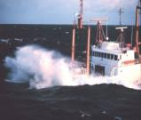
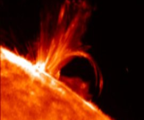
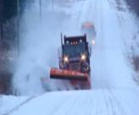
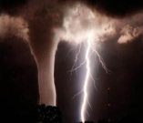
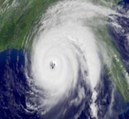

Topics
Overview of NCEP Centers, Structure, and NWP Suite
High Performance Computing
Current Data Usage
New Data Usage and Acquisition
Recent Model Upgrades
Planned Model Upgrades
Planned Data Acquisition Going Forward

Slide 3
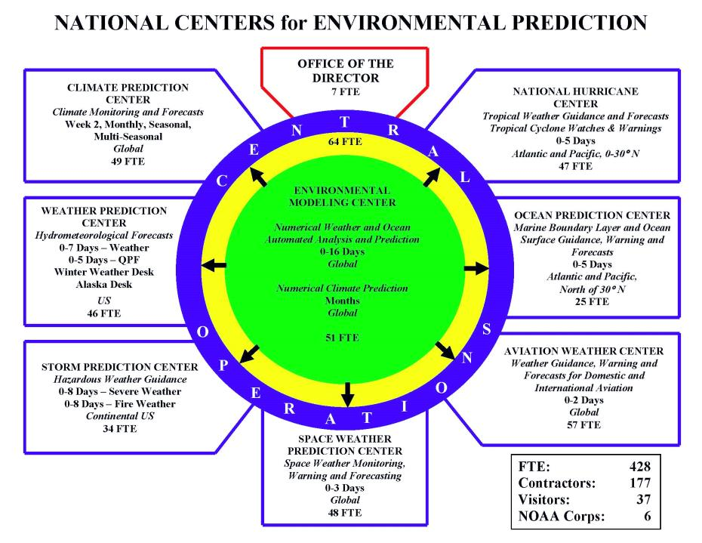


124 FTE

Slide 4
NOAA’s Operational Numerical Guidance Suite (Feb 2015)
Climate Forecast
System (CFS)
Regional Hurricane GFDL
WRF-NMM
Waves
WaveWatch III
SURGE
SLOSH
3D-VAR
DA
3D-VAR
DA
GFS, MOM4, GLDAS/LIS/Noah, Sea Ice
Ecosystem
EwE
Ocean (RTOFS)
HYCOM
P-SURGE
SLOSH
ESTOFS
ADCIRC
Regional Bays
Great Lakes (POM)
N Gulf of Mexico (FVCOM)
Columbia R. (SELFE)
Chesapeake (ROMS)
Tampa (ROMS)
Delaware (ROMS)
Global Forecast System (GFS)
3D-En-Var
DA
Regional NAM
NMMB
NOAH
Global Spectral
NOAH
3D-VAR
DA
Global Ensemble Forecast System (GEFS)
Dispersion
HYSPLIT
Short-Range Ensemble Forecast 21 members
21 GFS Members
Air Quality
WRF(ARW, NMM)
NMMB 7 members each
CMAQ
North American Ensemble Forecast System
Rapid Refresh
High Res Windows
3D-VAR
DA
GEFS, Canadian Global Model
WRF-ARW & NMMB
WRF ARW
North American Land Surface Data Assimilation System
NEMS Aerosol Global Component (NGAC)
Space
Weather
High-Res RR (HRRR)
3D-VAR
DA
WRF ARW
NOAH Land Surface Model
GFS & GOCART
ENLIL
Notes:
4

Slide 5
NCEP Computing Update
High Performance Computing
APSDEU-14 / NAEDEX-26 – NCEP Update – October 2015

Slide 6
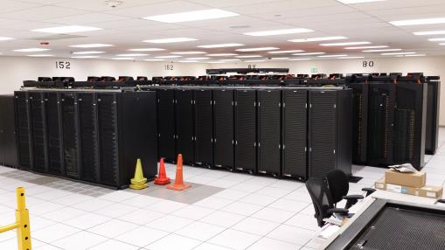
Weather & Climate Supercomputing System (WCOSS)
Location
Primary
Reston, VA (IBM provided facility) – Tide
Backup
Orlando, FL (IBM provided facility) – Gyre
Configuration
Identical Systems (per site)
IBM iDataPlex/Nextscale
831 trillion calculations/sec
35,840 processing cores
(Sandybridge/Ivorybridge)
4.62 petabytes of storage
Performance Requirements
Minimum 99.9% Operational Use Time
Minimum 99.0% On-time Product Generation
Minimum 99.0% Development Use Time
Minimum 99.0% System Availability
Failover tested regularly
Inputs and Outputs
Processes 3.5 billion observations/day
Produces over 15 million products/day
Significance
Where United States weather forecast process starts for the protection of lives and livelihood
Produces model guidance at global, national, and regional scales
Examples:
Hurricane Forecasts
Aviation / Transportation
Air Quality
Fire Weather
APSDEU-14 / NAEDEX-26 – NCEP Update – October 2015
Notes:
6

Slide 7
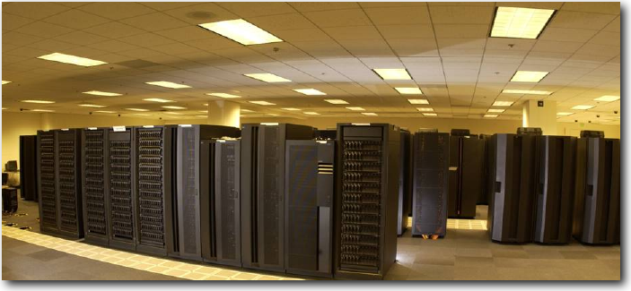
NOAA Research & Development Supercomputing
System | Location | Owner | Vendor | Capability (number and clock speed of cores) | %Avail NCEP
GAEA | Oak Ridge, TN | NOAA OCIO | CRAY | 127,168 Cores/ 1.1 PF AMD/Linux | 6.2%
Theia | Fairmont, WV | NOAA OCIO | CRAY | 26,112 Cores/ 1.076 PF Intel Haswell 2.6 GHz Linux | 44.8%
S4 | Madison, WI | U of Wi |  | 3,072 Cores AMD Opteron 2.2 GHz; 1600 Cores Intel Sandy Bridge 2.9 GHz Linux | No Set Limit
JIBB | Greenbelt, MD (GSFC) | JCSDA | IBM | 3,456 Cores/37.8 TF iDataPlex/Intel/Linux; 1900 Cores Intel SB 2.8 GHz | No Set Limit
Jet | Boulder, CO | NOAA OCIO | Aspen/ Supermicro | T-Jet 10,000 cores U-Jet 16,648 cores S-Jet 23,050 cores (all 421 TF) | 82% for HFIP
APSDEU-14 / NAEDEX-26 – NCEP Update – October 2015

Slide 8
HPC Growth
TeraFLOP per operational system
Built into the contract are capability and storage increases approximately every 3 years with no increase in funding
NOAA modeling plans rely heavily on “built-in” contractual increases
2015: WCOSS Phase 1: 208 TF
WCOSS Phase 2: 623 TF
(Dec) CRAY XC40: 2060 TF
Bridge
WCOSS
Phase 1
WCOSS
Ph. 1+2
WCOSS
Ph. 1+2
+ CRAY
APSDEU-14 / NAEDEX-26 – NCEP Update – October 2015

Slide 9
Weather & Climate Supercomputing System (WCOSS) 2015 Upgrade
Location
Primary
Reston, VA (IBM provided facility) – Luna
Backup
Orlando, FL (IBM provided facility) – Surge
Configuration
Identical Systems (per site)
CRAY XC40
+1704 compute nodes
2,060 trillion calculations/sec
46,672 processing cores
(Haswell)
3.5 petabytes of storage
APSDEU-14 / NAEDEX-26 – NCEP Update – October 2015
Notes:
9

Slide 10
FY14 – FY15 NCEP Computing Activities
CURRENT data Usage
APSDEU-14 / NAEDEX-26 – NCEP Update – October 2015

Slide 11
Conventional Data Usage
bold black: used; italicized: monitored
Observation type | Global Forecast System (GFS/GDAS) | North American Mesoscale (NAM/NDAS) | Rapid Refresh (RAP) | Real-Time Mesoscale Anal. (RTMA)
tropical cycle bogus | pstnl (storm center), uv | pstn, q (storm center), uv
rawinsonde (TAC) | pstn, Tv, q, uv, sst | pstn, Tv, q, uv, sst | pstn, Tv, q, uv
PIBAL | uv | uv | uv
dropwinsondes | Tv, q, uv | Tv, q, uv | Tv, q, uv
dropsonde splash-level | pstn, Tv, q | pstn, Tv, q | pstn, Tv, q
RECCO | Tv, q, uv | Tv, q, uv | Tv, q, uv
AIREP | Ts, uv | Ts, uv | Ts, uv
AMDAR (TAC) | Ts, uv | Ts, uv | Ts, uv
U.S. MDCRS | Ts, q, uv | Ts, q, uv | Ts, q, uv
Canadian AMDAR | Ts, uv | Ts, uv | Ts, uv
GPS-IPW | PWt | PWt | PWt
RASS | Tv | Tv | Tv
NPN wind profiler | uv | uv | uv
Multi-agency profiler |  | uv | uv
VAD winds | uv | uv | uv
JMA wind profiler | uv
SYNOP, METAR | pstn, Tv, q, uv, sst | pstn, Tv, q, uv, sst | pstn, Tv, q, mta_cld, uv | pstn, Tv, q, uv
ship, buoy, platforms | pstn, Tv, q, uv, sst | pstn, Tv, q, uv, sst | pstn, Tv, q, uv | pstn, Tv, q, uv
Mesonet |  | pstn, Tv, q, uv | pstn, Tv, q, uv | pstn, Tv, q, uv
mta_cld - METAR cloud amount, height of cloud base, present weather, visibility, dewpoint
pstn - station (surface) pressure PWt - total column precipitable water q - specific humidity sst - sea-surface temperature Ts - sensible (dry bulb) temperature Tv - virtual temperature u v - wind
APSDEU-14 / NAEDEX-26 – NCEP Update – October 2015

Slide 12
Conventional Data Received
NCEP 00Z GDAS ANNUAL DAILY MEAN RECEIVED CONVENTIONAL OBS
TOTAL COUNT
Thousands
YEAR
APSDEU-14 / NAEDEX-26 – NCEP Update – October 2015

Slide 13
Non-conventional Data
Usage
bold black: used; italicized: monitored
Instrument/product | Global Forecast System (GFS) | North American Mesoscale (NAM) | Rapid Refresh (RAP)
AMSU-A | NOAA-15/18/19(+RARS) METOP-A/B(+RARS) AQUA | NOAA-15/18/19 METOP-A AQUA | NOAA-15/18 METOP-A
MHS | NOAA-18/19 METOP-A/-B | NOAA-18/19 METOP-A | NOAA-18 METOP-A
HIRS-4 | NOAA-19 METOP-A/METOP-B | NOAA-19 METOP-A | METOP-A
AIRS-281 chn | AQUA | AQUA
IASI | METOP-A/B | METOP-A
SSM/IS UPP | DMSP F-16/F-17/F-18
GOES sounder radiances | GOES-13/GOES-15 (over water) | GOES-13/GOES-15 (over water)
SEVIRI/CSR | METEOSAT-10
ATMS | S-NPP
CrIS-399 chn | S-NPP
GOES imager cld-top press. |  |  | GOES-13/15 (NESDIS & LaRC)
SBUV ozone | NOAA-19
GOME ozone | METOP-A/B
OMI ozone | AURA
MLS ozone | AURA
NEXRAD L2 radial wind |  | yes | yes
NEXRAD L2 reflectivity |  |  | yes
APSDEU-14 / NAEDEX-26 – NCEP Update – October 2015

Slide 14
Non-conventional Data
Usage (cont.)
bold black: used; italicized: monitored
Instrument/product | Global Forecast System (GFS) | North American Mesoscale (NAM) | Rapid Refresh (RAP)
GPS-RO bending angle (**-GRACE-A not avail.?) | COSMIC1,2,5,6 **GRACE-A/GRACE-B METOP-A/METOP-B Terra-SAR-X TanDEM-X C-NOFS | COSMIC1,2,5,6 **GRACE-A/GRACE-B METOP-A/METOP-B Terra-SAR-X C-NOFS
AMV’s LW-IR | GOES-13/15 MTSAT-2 METEOSAT-7/10 AQUA/TERRA (MODIS) NOAA-15/18/19 (AVHRR) METOP-A/B (AVHRR) | GOES-13/15 MTSAT-2 METEOSAT-7/10 AQUA/TERRA (MODIS) NOAA-15/18/19 (AVHRR) METOP-A (AVHRR) | GOES-13/15 MTSAT-2 METEOSAT-7/METEOSAT-10 AQUA/TERRA (MODIS)
AMV’s SW-IR | GOES-13/15
AMV’s WV-cloud top | GOES-13/15 MTSAT-2 METEOSAT-7/10 AQUA (MODIS) | GOES-13/15 MTSAT-2 METEOSAT-7/10 AQUA (MODIS) | GOES-13/15 MTSAT-2 METEOSAT-7/10 AQUA (MODIS)
AMV’s WV-deep layer | GOES-13/15 MTSAT-2 METEOSAT-7/10 AQUA (MODIS) | GOES-13/15 MTSAT-2 METEOSAT-7/10 AQUA (MODIS) | GOES-13/15 MTSAT-2 METEOSAT-7/10 AQUA (MODIS)
AMV’s Visible | GOES-13/15 MTSAT-2 METEOSAT-7/10 | GOES-13/15 MTSAT-2 METEOSAT-7/10 | GOES-13/15 MTSAT-2 METEOSAT-7/METEOSAT-10
ASCAT scatterometer | METOP-A/METOP-B | METOP-A/METOP-B
RTMA/URMA: METOP-A and –B ASCAT used
AVMs (same as NAM) used at and below 850 mb
APSDEU-14 / NAEDEX-26 – NCEP Update – October 2015

Slide 15
Non-Conventional Data Received
NCEP 00Z GDAS ANNUAL DAILY MEAN RECEIVED NON-CONVENTIONAL OBS
TOTAL COUNT
Millions
YEAR
APSDEU-14 / NAEDEX-26 – NCEP Update – October 2015

Slide 16
Non-Conventional Assimilated Data
NCEP 00Z GDAS ANNUAL DAILY MEAN ASSIMILATED NON-CONVENTIONAL OBS
TOTAL COUNT
Millions
YEAR
APSDEU-14 / NAEDEX-26 – NCEP Update – October 2015

Slide 17
NEW Data Usage and Data acquisition SINCE LAST MEETING
APSDEU-14 / NAEDEX-26 – NCEP Update – October 2015

Slide 18
New Obs Ingested/ Obs Discontinued
May 2014 – December 2014
GOES-E and -W shortwave (3.9 μ) IR Winds (May 2014) (under eval.)
NOAA-16 decommissioned (Jun 2014)
TanDEM-X data GRS-RO data (Jun 2014) (under evaluation)
MODIS dust mask file (Aug 2014) (under evaluation)
NOAA Profiler Net. discontinued over CONUS (3 left in AK) (Aug 2014)
SSHA & wind/wave from SARAL/Altika & Cryosat-2 (Aug 2014) (eval.)
River Forecast Data (SHEF) (Sep 2014) (under evaluation)
BUFR marine subsurface glider data (Oct 2014) (under evaluation)
UrbaNet mesonet data (Dec 2014) (under evaluation)
Replace NOAA-18 ATOVS temp sndgs in CDAS with METOP-B (polar constellation with NOAA-19) (Dec 2014)
APSDEU-14 / NAEDEX-26 – NCEP Update – October 2015

Slide 19
New Obs Ingested/ Obs Discontinued (cont.)
January 2015 – July 2015
GOES Imager Effective Cloud Amount from UW (Jan 2015) (in RTMA)
BUFR-migrated ship & buoy data (March 2015) (under evaluation)
New surface marine stations, High-Density aircraft recon obs, new SHEF stations (Mar 2015)
Mexican, ADS-C & Air Wisc MDCRS (Apr 2015) (under evaluation)
TRMM/TMI mission ended (Apr 2015)
Wind profilers from Australia, N. Zealand & Samoa (Jun 2015) (eval.)
Ingest ENI total-lightning data (Jun 2015) (under eval)
GPS-Met (IPW/ZTD) [U.S. update, incl. GNSS (KBOU, EGRR)] (Jul 2015) (eval.)
Add 400+ new stations to METAR station table & 6 new stations in Great Lakes region to the USGS station table (Jul 2015)
APSDEU-14 / NAEDEX-26 – NCEP Update – October 2015

Slide 20
New Obs Ingested/ Obs Discontinued (cont.)
August 2015 onward
SSM/IS radiances from F-19 (Aug 2015) (under evaluation)
VIIRS POES AMVs (Aug 2015) (under evaluation)
WMO AMDAR v7 data from ARINC (Sep 2015) (under evaluation)
RARS data from S-NPP CrIS & ATMS (Sep 2015) (under evaluation)
Cryosat-2 & SARAL/Altika wind/wave with improved QC (in process)
EUMETSAT ASR (all-sky radiance) data (in process)
NASA AERONET station (surface-based) AOD data (in process)
Data from U.S. wind energy providers (in process)
Radar (VAD wind) data in BUFR from France & N. Zealand (in process)
APSDEU-14 / NAEDEX-26 – NCEP Update – October 2015

Slide 21
FY14 – FY15 NCEP Computing Activities
Model Upgrades SINCE LAST MEETING
APSDEU-14 / NAEDEX-26 – NCEP Update – October 2015

Slide 22
Model Upgrades May 2014 – Sep 2014
http://www.nco.ncep.noaa.gov/pmb/changes/
S. Francisco Bay Oceanographic Forecast System (SBOFS) impl. (May)
Hurricane Weather and Research Forecast (HWRF) Model upgrade v8.0 / GFDL Model upgrade v11.0 (June)
HWRF: incr. vertical resolution, larger domains, single Atlantic Ocean domain, updated WRF core, updated Princeton Ocean Model, updated GSI
GFDL: incr. horizontal resolution of inner nest, upgraded physics, upgraded Princeton Ocean Model with a unified Atlantic basin, refined vortex initialization
Observation Processing Suite Upgrade v3.0 (June)
Additional QC information in AMV dump files (used in next GFS upgrade)
Estimated pmsl now encoded in PrepBUFR file for sfc reports where missing (under evaluation in RTMA/URMA)
Sfc marine reports with calm winds & background wind > 5 m/sec flagged bad
Sfc Coast Guard mass and wind data now encoded in PrepBUFR file (used)
Sfc reports with incomplete wind information now retained and encoded into PrepBUFR file (under evaluation in NAM and RTMA/URMA)
Sfc SYNOP, METAR, marine, mesonet reports with missing pressure now stored in PREPBUFR file (used in next NAM and RTMA/URMA upgrade)
APSDEU-14 / NAEDEX-26 – NCEP Update – October 2015

Slide 23
Model Upgrades May 2014 – Sep 2014 (cont.)
HiRes Window (HiResW) upgrade v6.0 (June)
Resolution changes, schedule changes, addition of full CONUS domain
Extratropical Surge & Tide Operational Forecast System for Pacific Ocean model (ESTOFS-Pacific) implementation (June)
Nowcasts & fcst guidance of water level conditions for W. coast, Gulf of AK, HI
Global Wave Ensemble System (GWES) upgrade v3.0 (July)
Higher res. spatial & spectral grids, new physics package, expansion of outputs
Probabilistic Storm Surge (PSURGE) model implementation v2.3 (July)
North American Land Data Assimilation System (NLDAS) impl. (Aug)
Enhances drought monitoring & prediction
Observation Processing Suite Upgrade v3.1 (Aug)
Includes more robust aircraft QC processing (used in all applicable systems)
APSDEU-14 / NAEDEX-26 – NCEP Update – October 2015

Slide 24
Model Upgrades May 2014 – Sep 2014 (cont.)
North American Mesoscale (NAM) Analysis and Forecast System (NAM) upgrade v3.2 (Aug)
Obs changes: use RTMA mesonet wind reject list, replace use of refractivity with bending angle for GPS-RO, add GOES-15 radiances, add Meteosat-10 AMVs with thinning; add Level 2 VAD winds (higher vertical & temporal resolution), assimilate sfc obs. with missing pressure
Analysis changes: use hybrid variational ensemble GSI analysis with the NCEP Global Ensemble Kalman Filter (EnKF), add new satellite bias correction scheme, add Variational Quality Control; use GFS ozone analysis in the satellite radiance assimilation
Model changes: update radiation, gravity wave & drag/mountain blocking scheme, add new version of convective parameterization scheme, upgrade microphysics, reduce roughness length for 5 vegetation types, run all nests except 6 km Alaska domain with explicit convection
Automated Sea Ice Drift Model upgrade v4.0.0 (Sep)
Model changed to ensemble-based system
Real-Time Mesoscale Analysis/Unrestricted Mesoscale Analysis (RTMA/URMA) update to assimilate surface obs with missing pressure (Sep)
APSDEU-14 / NAEDEX-26 – NCEP Update – October 2015

Slide 25
Model Upgrades May 2014 – Sep 2014 (cont.)
High-Resolution Rapid Refresh (HRRR) Analysis & Forecast system implementation v1.0 (Sep)
F000-F015 every 15 min, similar to RAP but much higher resolution (3 km) and allows explicit convection, radar assimilated every 15 min / allow a one-hour “spinup” forecast / and final 3km GSI
Gulf of Mexico Ocean Forecast Systems update (Sep)
Existing NGOFS system upgraded, new systems for NE & NW Gulf of Mexico implemented
Hybrid Single-Particle Lagrangian Integrated Trajectory (HYSPLIT) Model upgrade v7.2.0 (Sep)
Includes smoke and dust guidance
Updated automated detection of fires in Canada, Mexico and Central America that provide inputs for smoke emissions for smoke predictions
Added 3-D particle model approach to properly represent additional fires identified with automatic fire detection
APSDEU-14 / NAEDEX-26 – NCEP Update – October 2015

Slide 26
Model Upgrades Oct 2014 – Sep 2015
http://www.nco.ncep.noaa.gov/pmb/changes/
Extra-tropical Storm Surge (ETSS) upgrade v1.5 (Oct)
Switch to using the 0.5 degree GRIB2 GFS winds
Creation of outputs on the 2.5 km NDFD CONUS and 3 km NDFD Alaska grids
Observation Processing Suite Upgrade 4.0 (Nov)
Fixed bug in tropical cyclone synthetic data bogus processing
Radar reflectivity mosaic generated every 15 min instead of every 60 min
Global Wave Model upgrade v3.2 / Hurricane Wave Model upgrade v3.0 (Jan)
Updates to bathymetric grids and regional masks
Upgrade of wave model physics (for the Hurricane Wave Model)
Use of the HWRF winds in the Hurricane Wave Model
APSDEU-14 / NAEDEX-26 – NCEP Update – October 2015

Slide 27
Model Upgrades Oct 2014 – Sep 2015 (cont.)
Global Data Assimilation System/Global Forecast System (GDAS/GFS) upgrade v12.0 (Jan)
Obs changes: assimilate SSM/IS UPP and METOP-B IASI radiances, assimilate hourly GOES and METEOSAT AMVs; use 6 hours of GOES AMVs vs. 1 hour; monitor AVHRR POES and GOES 3.9 micron channel AMVs
Analysis changes: enhanced data assimilation, T574 EnKF, update radiance assimilation
Model changes: 0.25 degree resolution (T1534), improved physics, extend hi-res to 10-days, 3 hourly output through F240, GFS MOS upgrade
Great Lakes Wave (GLW) model upgrade v3.3 (Jan)
Increased spatial grid resolution from 5km to 2.5km
Increased spectral resolution to expand the range to 1 Hz
Increased resolution of input wind fields from the NAM smartinit files
Improved ice concentration analysis
Update of the WAVEWATCH III code used by the GLW from v4.7.1 to v4.15.1
APSDEU-14 / NAEDEX-26 – NCEP Update – October 2015

Slide 28
Model Upgrades Oct 2014 – Sep 2015 (cont.)
Community Multi-scale Air Quality (CMAQ) upgrade v4.6 (Jan)
Uses 1-hour backward average daily particulate matter
Updated carbon bond gas phase (CB05) mechanism
GFS-Based MOS Warm Season Refresh (April)
Real-Time Mesoscale Analysis/Unrestricted Mesoscale Analysis (RTMA/URMA) upgrade v2.3 (April)
Assimilate METOP-B ASCAT
Assimilate GOES Imager Effective Cloud Amount (“sky cover”) from U. Wisc for RTMA CONUS and URMA
HRRR/NAM Nest blend for the first guess replaces RAP
Enhancement of precipitation look-back
Extra-Tropical Storm Surge (ETSS) upgrade v2.0 (May)
include overland calculations based on surge only for the East Coast and Gulf of Mexico
coarse ETSS gridded products will no longer be available
new text format
APSDEU-14 / NAEDEX-26 – NCEP Update – October 2015

Slide 29
Model Upgrades Oct 2014 – Sep 2015 (cont.)
Hurricane Weather and Research Forecast (HWRF) Model upgrade v9.0 / GFDL upgrade v13.0 (June)
GFDL: Hurricane Prediction System upgraded, improved moisture initialization & specification, improved forecast for weaker storms, correct specification of ocean currents in surface flux computation
HWRF: resolution increases; upgrades to physics, DA vortex initialization
BUFR library upgrade v11.0.0 (Aug 2015)
Dynamic array allocation, added functionality, bug fixes
Observation Processing Suite upgrade v5.0 (Aug)
New land/sea mask retains marine reports previously tossed as over land
Added hourly early (T+0:16) HRRR dump of NeXRAD WSR-88D Level 2 reflectivity/radial wind data (under evaluation for next HRRR upgrade)
Gross check for unrealistically high moisture obs in RAP
Improved vvel calculation (using Tension Spline interpolation) in aircraft QC vertical profiles (used in bias correction generation in next GSI upgrade)
HiRes Window (HiResW) model upgrade v6.1 (Sep)
Increase in vertical resolution, modifications to parameterized physics, new product fields, new High-Resolution Ensemble Forecast suite of products
APSDEU-14 / NAEDEX-26 – NCEP Update – October 2015

Slide 30
FY16Q1/FY16Q3 – NCEP Computing Activities
Planned Model Upgrades
APSDEU-14 / NAEDEX-26 – NCEP Update – October 2015

Slide 31
Planned Model Upgrades Oct 2015 – Jun 2016
http://www.nco.ncep.noaa.gov/pmb/changes/
Short Range Ensemble Forecast (SREF) upgrade v7.7 (sch. Oct 2015 → delayed)
Increase the total members from 21 to 26, increase number of vertical levels
Gridded Localized Aviation Model Output Statistics Program (G-LAMP) upgrade v1.1.0 (sch. Oct 2015)
LAMP will be upgraded on NDGD to include new elements
The GFS MOS will also be upgraded v4.2.2, add day 8-11 products
NAM Model Output Statistics (MOS) update (sch. Oct 2015)
New equations for snowfall amount forecasts
New NAM MOS probabilistic & categorical guidance for cool-season precipitation type
Extra-tropical Storm Surge (ETSS) upgrade v2.1 – Alaska (sch .Oct 2015)
New Alaskan basin
APSDEU-14 / NAEDEX-26 – NCEP Update – October 2015

Slide 32
Planned Model Upgrades Oct 2015 – Jun 2016
Aviation Weather Center's Graphical Turbulence Guidance (GTG) suite implementation (sch. Oct 2015)
Moved from AWC to NCEP’s WCOSS
Global Ensemble Forecast System (GEFS) upgrade v11.0 (sch. Oct 2015)
Major upgrade, running latest GFS, increased horizontal (T254 to TL574 first 192 hrs) and vertical resolution (42 to 64 levels), 0.5 deg resolution output.
Global-Real Time Ocean Forecast (RTOFS) upgrade v1.1 (sch. Nov 2015)
Increase number of vertical layers from 32 to 41T
Updated bathymetry
An update of the climatology
Added products
Community Multi-scale Air Quality (CMAQ) upgrade v4.7 (sch. Nov 2015)
Improved chemistry mechanism & vertical transport
Inclusion of additional vertical levels (35 levels)
APSDEU-14 / NAEDEX-26 – NCEP Update – October 2015

Slide 33
Planned Model Upgrades Oct 2015 – Jun 2016
Implementation of Global Current Icing Potential (GCIP) in-flight icing analysis products (sch. Nov 2015)
Used to verify GFS World Area Forecast System (WAFS) Global Icing Forecast
Real Time Ocean Forecast System (RTOFS)-Atlantic upgrade v3.0 (sch. Nov 2015)
New initialization
Improved DA algorithms for SSH, and sub-surface profiles
NOAA Environmental Modeling System Global Forecast System (GFS) Aerosol Component (NGAC) upgrade (sch. Dec 2015)
Upgraded aerosol model
Extend aerosol species from dust only to multi-species (dust, sea salt, sulfate, organic carbon and black carbon aerosols) to provide aerosol forecast using near real global biomass burning emission data
Add 12Z cycle forecast
APSDEU-14 / NAEDEX-26 – NCEP Update – October 2015

Slide 34
Planned Model Upgrades Oct 2015 – Jun 2016
Real-Time Mesoscale Analysis/Unrestricted Mesoscale Analysis (RTMA/URMA) upgrade v2.4 (sch. Dec 2015)
Add NAM smartinit downscaling for westward extended CONUS domain
Use Stage IV hourly as primary source of precip
Implement URMA systems for Alaska
Analyze min/max temperature
Use new observation variational quality control within the GSI
Use EMC/GFE common topography and land/sea mask fields
Synchronize all RTMA/URMA applications to use the same code
North American Ensemble Forecast System (NAEFS) upgrade v5.0/ Climatologically Calibrated Precipitation Analysis (CCPA) (sch. Jan 2016)
Climate Forecast System (CFS) upgrade v2.2 (sch. Jan 2016)
Update of GSI
APSDEU-14 / NAEDEX-26 – NCEP Update – October 2015

Slide 35
Planned Model Upgrades Oct 2015 – Jun 2016
Hybrid Single-Particle Lagrangian Integrated Trajectory (HYSPLIT) Model upgrade v7.4 (sch. Jan 2016)
Add trajectories for lake effect snow forecasts (WFO request)
Upgrade to BlueSky v3.5.1 smoke emissions
Nearshore Wave Prediction System (NWPS) upgrade v1.0 (Feb 2016)
Involves separate implementations for approx. 20 WFOs, shared scripting
Novel on-demand run triggering
Centralized implementation of NWPS that is currently run locally at a number of coastal WFOs
Rapid Refresh (RAP) Analysis and Forecast System upgrade v3.0 / High-Resolution Rapid Refresh (HRRR) upgrade v2.0 (sch. Feb 2016)
Upgrade to assimilation of radar reflectivity data
Upgrades to model core and initialization
Expansion of RAP domain to match NAM domain
Extension of forecast length for both models
APSDEU-14 / NAEDEX-26 – NCEP Update – October 2015

Slide 36
Planned Model Upgrades Oct 2015 – Jun 2016
North American Land Data Assimilation System (NLDAS) upgrade v3.0 (sch. Feb 2016)
Cover NAM domain (North America) with higher-resolution (3-4km) than the current 0.125-deg, and include improved surface forcing (e.g. precipitation), upgrades to land model physics and land data sets
Global-Real Time Ocean Forecast System (RTOFS) upgrade v1.1.1 (sch. Mar 2016)
Great Lakes Wave (GLW) upgrade v3.4 (sch. Mar 2016)
Great Lakes Operational Forecast System (GLOFS) [Lake Erie Operational Forecast System (LEOFS) v2.0.0] upgrade (sch. March 2016)
Global Wave Ensemble System (GWES) v3.1 (sch. May 2016)
Global Data Assimilation System/Global Forecast System (GDAS/GFS) upgrade (sch. May 2016)
Upgrade to 4D hybrid EnVar data assimilation
APSDEU-14 / NAEDEX-26 – NCEP Update – October 2015

Slide 37
Planned Model Upgrades Oct 2015 – Jun 2016
North American Mesoscale (NAM) Analysis and Forecast System (NAM) upgrade v4.0 (sch. Jun 2016)
Obs changes: assimilate SEVIRI CSR; SSM/IS F-17/18; METOP-B IASI, HIRS-4, AMSU-A, MHS; S-NPP ATMS, CRIS
Analysis changes: upgrades to GSI analysis and data assimilation, NDAS changed to do hourly cycle (NAM Rapid Refresh (NAMRR)) with catchup cycle off GDAS every 6-h or 12-h ​ 4-d version of hybrid GSI analysis (tentative), tropical cyclone relocation
Model changes: upgrade NMMB prediction model, increase resolution of CONUS and Alaska nests to 3 km, physics changes to improve model biases and convective structure
Global Wave Grids upgrade (sch. Jun 2016)
APSDEU-14 / NAEDEX-26 – NCEP Update – October 2015

Slide 38
PLANNED Data acquisition GOING FORWARD
APSDEU-14 / NAEDEX-26 – NCEP Update – October 2015

Slide 39
Future plans: Observational Data
Jason-3 altimeter SSHA, wind/wave (after launch)
Reintroduce WindSat scatterometer winds (format change at NRL)
CrIS full spectrum resolution [2223 chn (2211 regular chn + 12 guard chn)]
S-NPP VIIRS: radiances, SST, AOD, smoke, dust, Green Vegetative Fraction (GVF)
ISS RapidScat
Direct readout of AIRS, CrIS, ATMS, AMSU-A, HIRS-4, MHS, IASI from UW/SSEC
Global geostationary satellite composite mosaic imagery files (SSEC)
Burned area & blended Global Biomass Burning Emissions Products
Geostationary Surface & Insolation Product (GSIP) [daily global file, full disk (GOES-E & W), ext. NHem (GOES-E & W), full disk (MTSAT-2), full disk (METEOSAT-10)
APSDEU-14 / NAEDEX-26 – NCEP Update – October 2015

Slide 40
Future Observational Data (cont.)
MDCRS from Sky West, Alaska, additional ADS sources, etc.
TAC to BUFR: AMDAR, SYNOP, Upper-air, SHIP, BUOY
Improved mesonet roadway data
GPS-RO from Oceansat-2, SAC-D, Megha-Tropiques, KOMPSAT-5
Aeolus ADM
Sentinel SSHA, wind/wave and ocean color data
SEVIRI ASR
GPM-CORE radiances, precipitation retrievals
AMSR-2 radiances and SST
Himawari-8 AMVs, CSR, and raw AHI radiances
Megha-Tropiques SAPHIR
GOES-R
APSDEU-14 / NAEDEX-26 – NCEP Update – October 2015

Slide 41
Questions ???
Where America’s Climate, Weather, Ocean, and Space Prediction Services Begin”
“From the Sun to the Sea…
Where America’s Climate, Weather, Ocean and Space Weather Services Begin”
APSDEU-14 / NAEDEX-26 – NCEP Update – October 2015

